Slide 1
Nurses Role in Health Equity: Crucial Collaboration Leveraging SDOH Tools
HIMSS Nursing Informatics Community Webinar
October 26, 2021

Slide 2


Welcome
Cait Michicich, MBA
Program Manager, Clinical Informatics, HIMSS

Slide 3
HIMSS Nursing Informatics Community
The Nursing Informatics Community’s purpose is to articulate a cohesive voice for the HIMSS Nursing Informatics community and to provide domain expertise, leadership and guidance to HIMSS activities, initiatives, and collaborations with the global nursing informatics community.
Educational webinars qualified for CA/CPHIMS on nursing informatics topics and emerging trends
www.HIMSS.org/NI
#Nurses4HIT
Notes:
Invite you all to join HIMSS as an individual or through your organization

Slide 4

Join us on Accelerate!
Join Accelerate today at YourAccelerate.com
Accelerate is a natural extension of HIMSS's origins and foundation as a member-driven society, and is an innovative solution aimed to support members, partners and the global health ecosystem 365 days a year.
Register with your email, password, and personal invite code: MVPNI
Notes:
ADD THE UNIQUE LINK TO JOIN

Slide 5
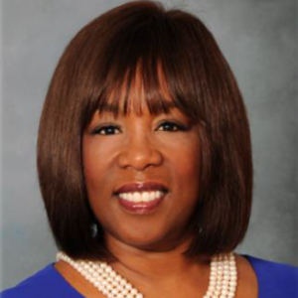
Welcome
Angela Ross, DNP, MPH, PMP, PHCNS-BC
Associate Professor
Program Coordinator, Doctorate in Health Informatics
UTHealth School of Biomedical Informatics

Slide 6

Learning Objectives
Define social determinants of health data and the context for their use
Review successful implementations of SDOH tools including the role of nursing collaboration
Establish factors to consider when implementing SDOH tools, especially within nursing workflows
Describe the Nurse Informaticist's role in identifying SDOH requirements in People, Process, and Technology

Slide 7
Agenda
Introductions
Introduction to Health Equity and Social Determinants of Health
Dyad 1
  Use Case- NowPow
Dyad 2
  Use Case- Aunt Bertha
Community Needs
Advice for Nurses
Q&A

Slide 8
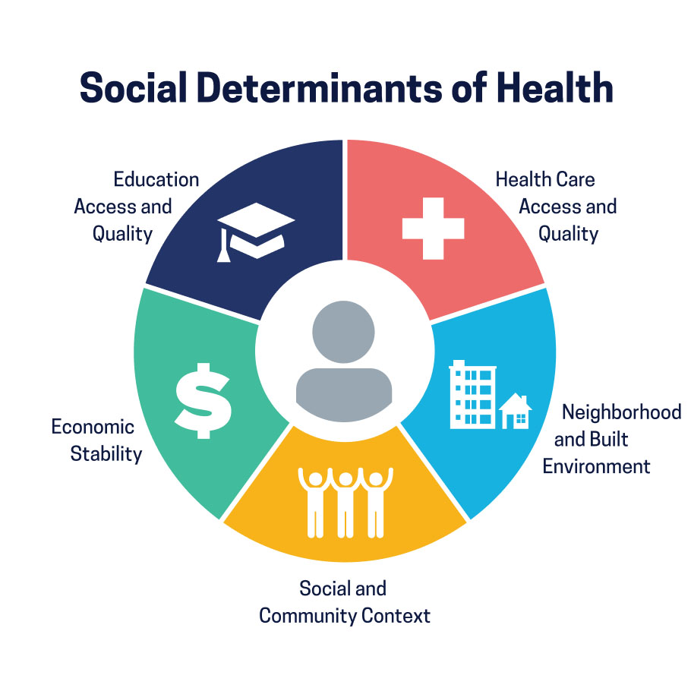
SDOH and Impact to Health Outcomes
~80% of a person’s health is determined by socioeconomic factors, health-related behaviors and environmental conditions¹
Social Determinant of Health (SDOH): the conditions in which people are born, grow, live, work and age, and have gained recognition for the broad impact these conditions have on health, health equity and overall well-being¹.
5 Domains³:
  Economic stability
  Social and Community Context
  Neighborhood and Built Environment
  Health Care Access and Quality
  Education Access and Quality
Robert Wood Johnson Foundation. Medicaid’s Role in Addressing Social Determinants of Health. 2019. Accessed February 10, 2021 from https://www.rwjf.org/en/library/research/2019/02/medicaid-s-role-in-addressing-social-determinants-of-health.html
Social Determinants of Health | HIMSS
Healthy People 2030, U.S. Department of Health and Human Services, Office of Disease Prevention and Health Promotion. Retrieved [date graphic was accessed], from https://health.gov/healthypeople/objectives-and-data/social-determinants-health
Notes:
food security, socioeconomic status (income, educational attainment and subjective perception of social status), access to care, reliable transportation, safe housing, neighborhood characteristics and the composition of a person’s social support network.

Slide 9
Current Healthcare IT Landscape
Health systems, local agencies, and communities seeking tools to meet manage patient populations, gain insight to needs and direct care resources.
Population Health Management Partners
  Multiple vendors
  Offers care coordination platforms to direct outreach of community-based services.
EHR Technology
  EHR offers care coordination workflows
  EHR offers some integration to vendor solutions, community resources, and health agencies

Slide 10


DYAD 1

Slide 11
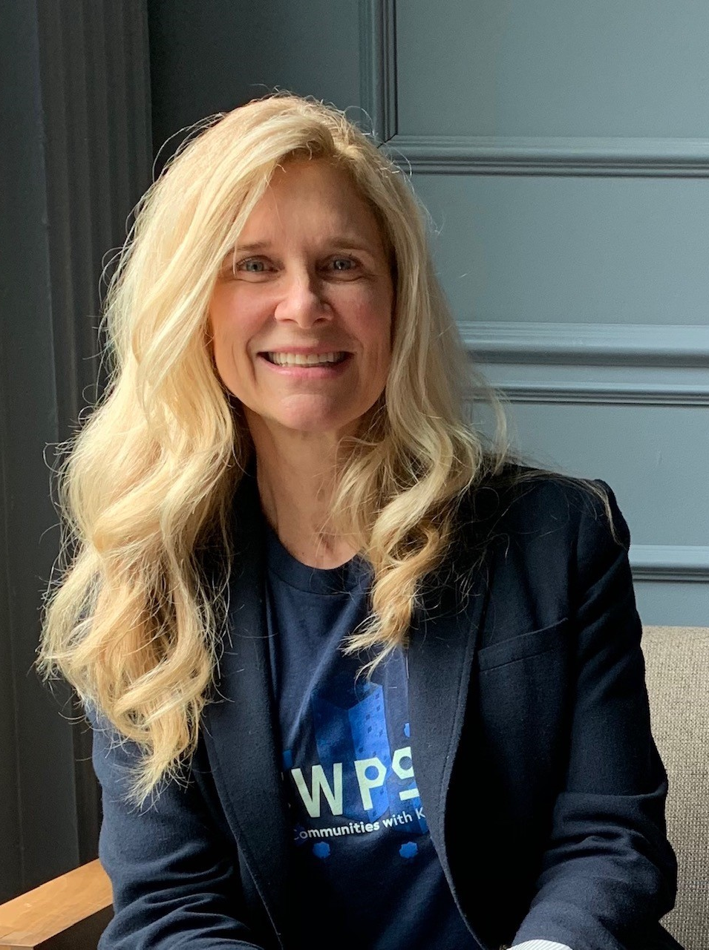
Cathryn DeGraff Crookston
RN, BSN
VP Sales & Business Partnerships, NowPow
Cathryn professional experience has an equal balance as a clinical provider of care and in health IT. Today, she is the VP of Sales & Business Partnerships at NowPow, a women-owned and led healthcare technology company that integrates community care into healthcare. With NowPow care providers “e-prescribe” community services to reduce negative effects of Social Determinants of Health (SDoH) and support Whole Person Care. She is also the co-chair of the HIMSS SDOH Task Force, is a member of the NYS HIMSS Nursing Committee, the Chicago Society of Participatory Medicine, Purdue University’s School of Nursing Advisory Committee and Northwestern Medicine’s Patient & Family Advisory Council.

Slide 12
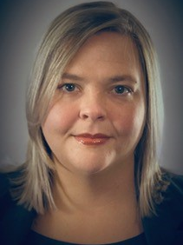
Starla Reid, MSN RN
RN Continuum of Care Manager
Care Coordination Institute
Prisma Health-Upstate
Starla Reid, MSN RN, is a Nurse Continuum of Care Manager for the Prisma Health Care Coordination Institute in Greenville, SC. She earned a Bachelor of Science in Nursing degree from the University of South Carolina in 2008 and began her career in the CICU. Other nursing roles held include Nurse Auditor, Patient Referral and Transport Coordination, Hospital Billing Revenue Integrity, and Home Hospice. As the organization transitioned to an electronic health record documentation system, Starla recognized the need for a clinical voice to be present during the build of such platforms, leading to Starla achieving a Master of Science in Nursing Informatics from Walden University in 2016. Starla began working for the Prisma Health Care Coordination Institute in 2018 serving the community in the Complex Care Manager role with additional responsibilities in systems and training as the department was transitioning to a new electronic documentation platform.

Slide 13



Community health and equity impact
“If our goal is to eliminate health disparities, we have to turn serious attention to understanding and providing people high-quality connections to vital health-promoting resources in our communities.”
LINCOLN PARK
Average Life Expectancy:
81 YEARS
Median Household Income:
$89,657
10 MILES / 12 YEARS
Stacy Lindau, MD, MAPP
NowPow founder and chief innovation officer
Forbes, October 8, 2020
WASHINGTON PARK
Average Life Expectancy:
69 YEARS
Median Household Income:
$25,390
https://www.forbes.com/sites/sethjoseph/2020/10/08/covid-19-subway-stops-and-health-equity-how-digital-health-platforms-help-reduce-disparities-in-care/#178272e644ca

Slide 14

Whole person care, whole communities
NowPow is a personalized community referral platform.
We make it easy to connect people to the right community resources.
We uniquely support all people and networks of all sizes and sectors to comprehensively advance population health.

Slide 15
Build trust
Referral quality really matters
The risk of making a poor quality referral is high.
A poor quality referral wastes time and erodes trust.
We focus on three components: referral fit, referral efficiency and referral success to drive intervention outcomes.
Fit
Referral Quality
Efficiency
Success

Slide 16
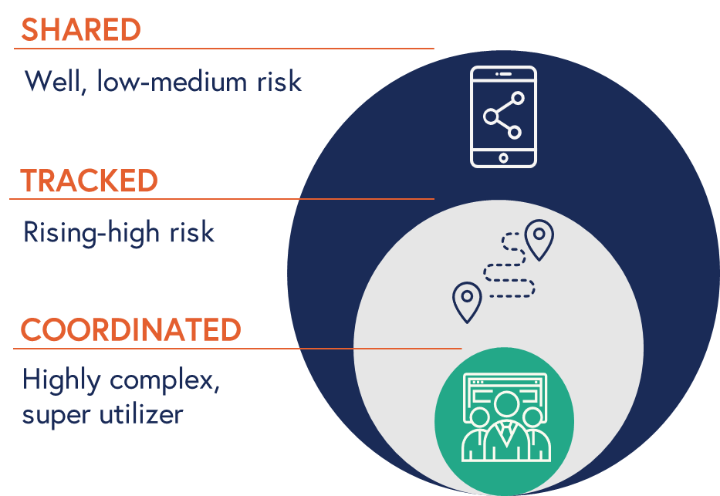
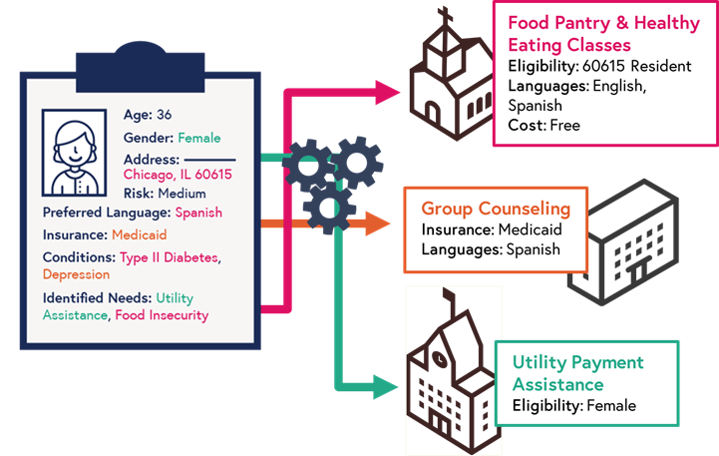
Personalize all referrals
Advance matching logic
3 types of referrals

Slide 18
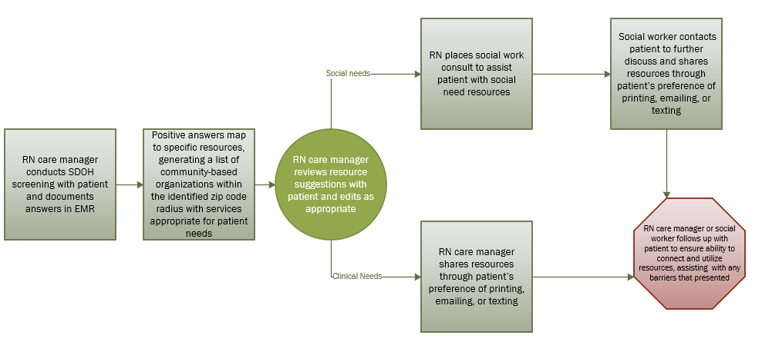

Prisma Health: ACO Referral Workflow

Slide 19
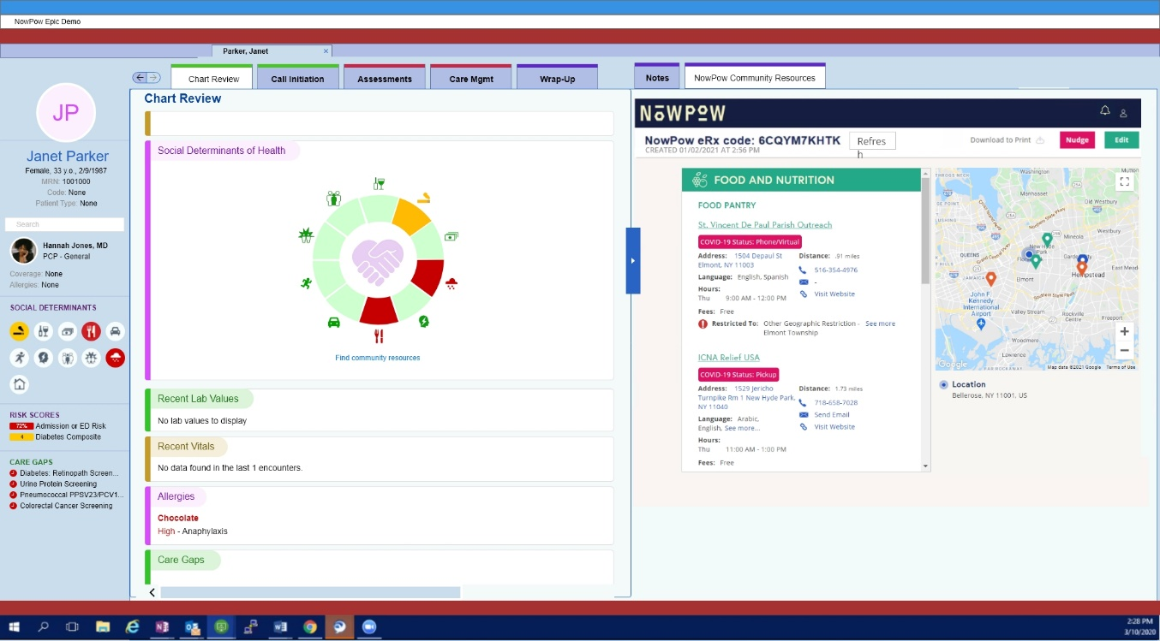
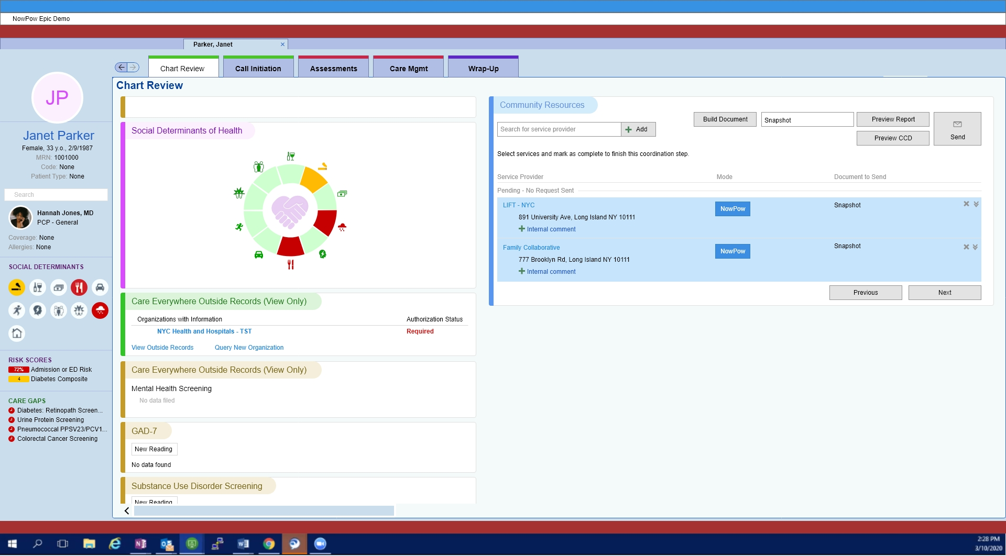
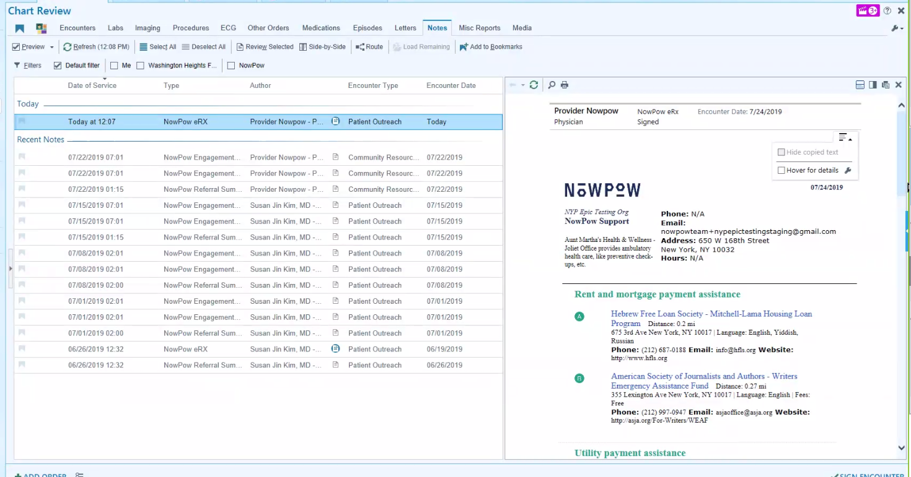
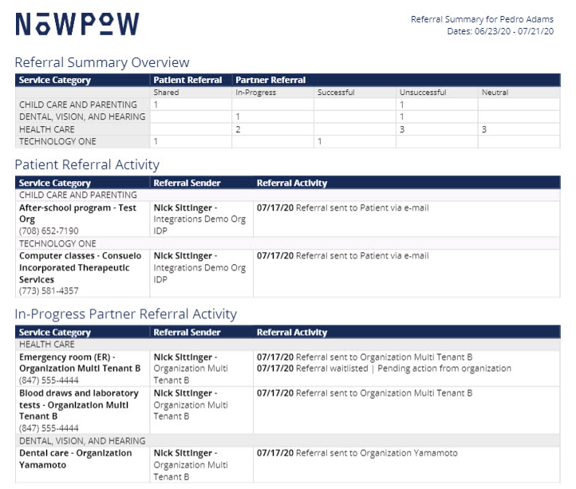
Integration to leverage bi-directional data sync​
3
2
1
1
People Data
2
Screening Data
NowPow Platform
EHR
HealtheRx
3
Referral Summary
4
4

Slide 20
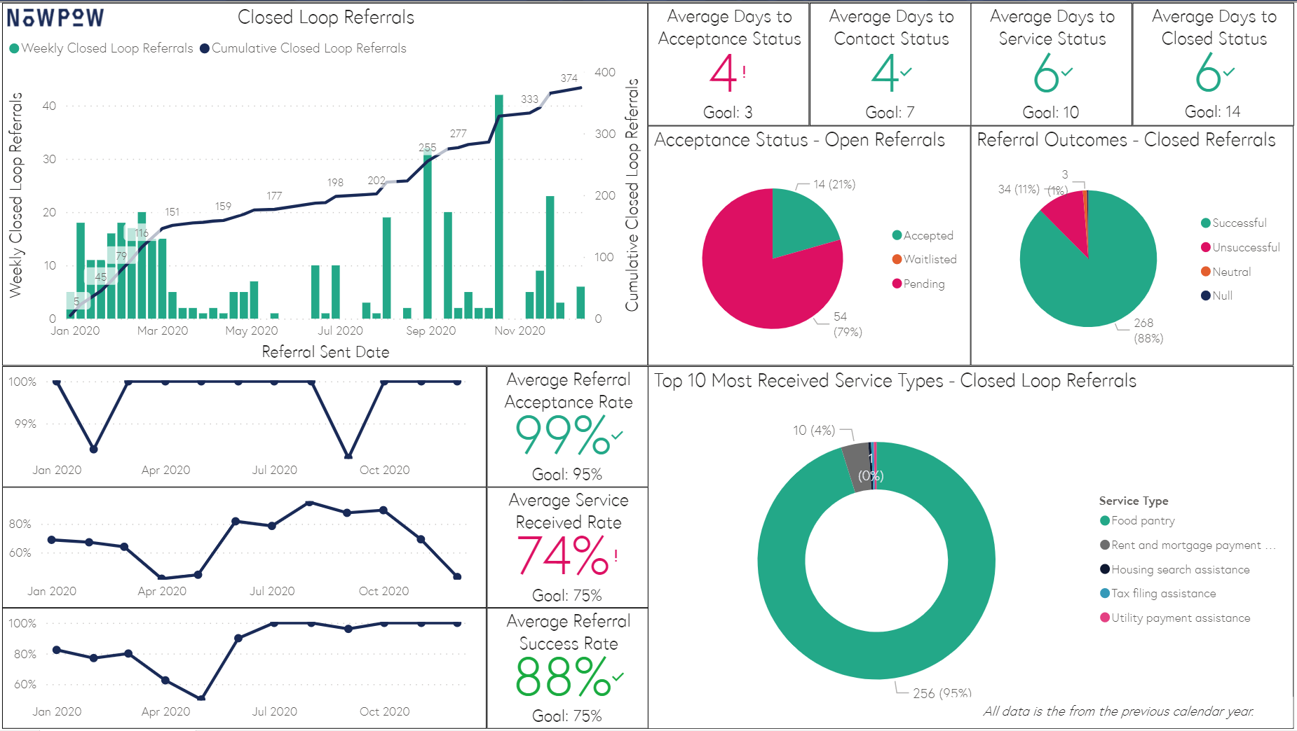
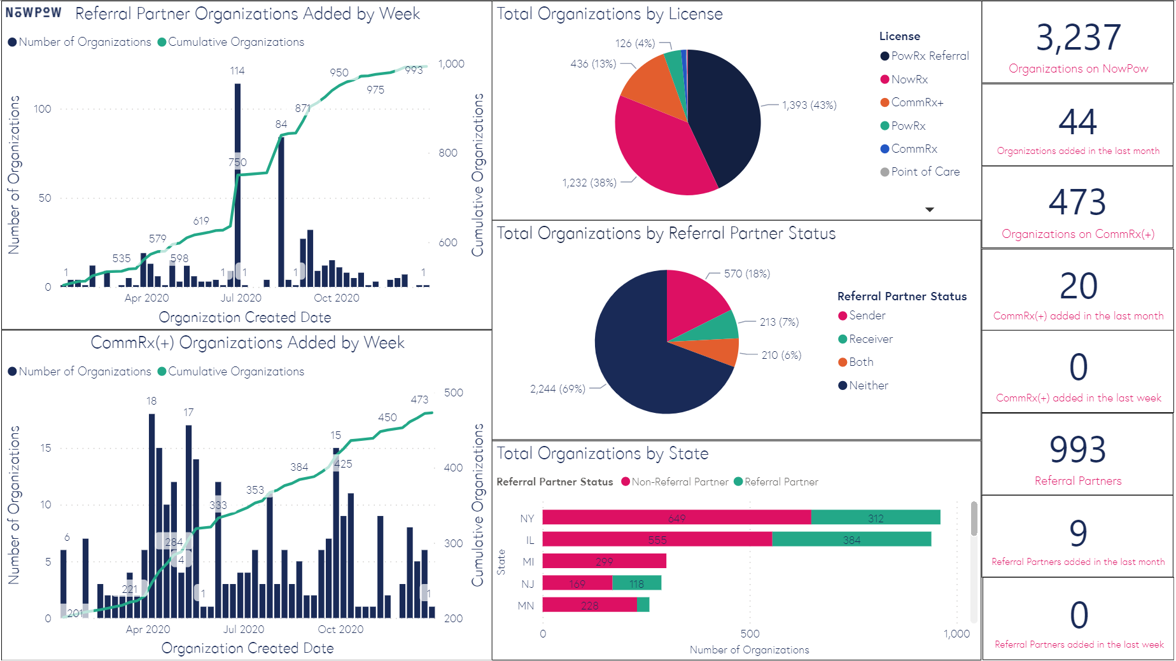
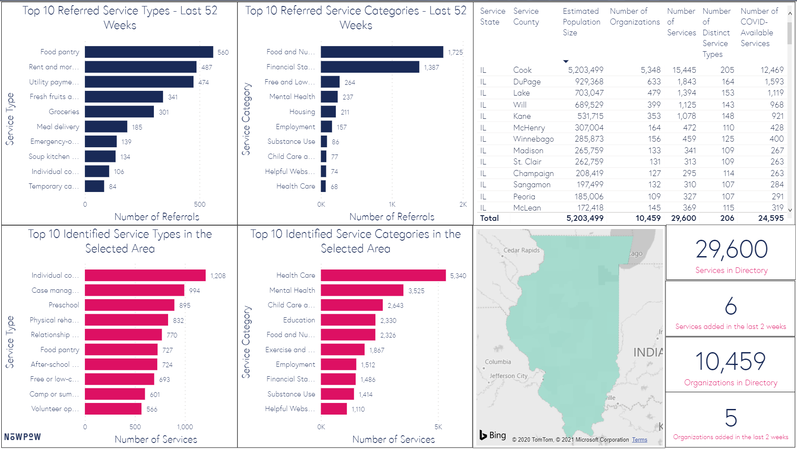
Analytics to understand needs and impact
Data guides action
Analytics offering includes on-demand reporting, interactive dashboards, raw data packages and custom analytics support
Understand prevalence and distribution of social needs to feed predictive models, inform care and understand equity
Drive successful resource connection, including referral outcomes and barriers to care
Optimize referral networks that effectively support the needs of the population served
Support data driven resource investment and policy development with deepened understand of resource supply & demand

Slide 21


DYAD 2

Slide 22

Kaitlyn Steepy
Senior Customer Success Manager
Aunt Bertha, a Public Benefit Corporation
Kaitlyn's background is rooted in health information technology, focusing on EHR and software implementation. Her career path led to her current role with Aunt Bertha, the nation's largest search and referral network. Drawing from healthcare tech and global consulting experience, Kaitlyn partners with and supports Atrium Health and other healthcare systems across the U.S. Together, these organizations are leveraging the power of technology to improve health equity through SDoH initiatives for vulnerable populations.

Slide 23

Jamie Sunde
MPH, MBA, CPHQ
Senior Management Associate
Community Health, Atrium Health
Jamie has worked her entire career in the Healthcare industry, beginning in healthcare quality within a Community Health Clinic and Federally Qualified Health Center (FQHC) system in southern California. Most recently, she has spent the last 9 years focused on Community Health at Atrium. Jamie is focused on improving access and the delivery of meaningful and equitable health care to the underserved and underinsured through community program planning with prevention, lifestyle change, and policy development.

Slide 24



It’s too hard to navigate the system.
Seeker
Programs

Slide 25
We’re trying to make it easier…
Browse social service programs across service categories
Seeker
Programs
Search by zip code
Securely connect to programs that fit your needs

Slide 26






…by enabling success with your patient populations.
Connected patients
Report on SDoH outcomes and patient successes
Healthcare Organization
Build network and community focus
Track referrals and
close the loop
Data-driven results

Slide 27

Nationwide Network
Ready on Day One
Free Suite of Tools for Community Organizations
Integrate Into Your Workflows and EHRs
Open & Focused

Slide 28




1600
Employees Trained
Pilot
Focus
Scaling
Measurement
245 Programs Claimed
17714 Connections
4585 Referrals since 2018
Atrium Health’s Community Resource Hub
6000+ Children Screened for SDoH in Pilot Year
400+ CBO Contacts in Progress
73% Closed Loop Referrals
Notes:
- Piloted with SW, Care Managers, Patient Advocates, Navigators → grew to referral coordinators, Community Health Workers ID’d as a need
- Began with food insecurity and has grown to food, housing and employment
- Scaled with regional partners as health system grew
- Worked through networks and organically implemented

Slide 29

Community Representative

Slide 30

Mary Ellen McEvoy
RN, MSN, MPH
Director of Clinical Operations
Healthcare for the Homeless
Mary Ellen McEvoy joined Healthcare for the Homeless as the Director of Clinical Operations in 2019. She has had previous experience in Federally Qualified Health Center leadership as Chief of Compliance, Director of Nursing, and as clinic RN, all of which required oversight of clinical quality processes. Prior to working in FQHC programs, Mary Ellen worked in medical tourism in Mexico, Community Mental Health in British Colombia and Washington, D.C. as well as Maternal Health(Labor and Delivery, antepartum, post partum, and high-risk prenatal care).

Slide 31
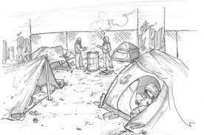





Social Determinants of Health – On the Ground in Homeless Healthcare
32

Slide 32
Social Determinants of Health – On the Ground in Homeless Healthcare
Assessing Social Determinants:
  Immediate insight into patient priorities and needs
    How are we connected in the community?
    Who helps the patient make these connections?
  Risk categories and employing resources effectively
    Is there a set of social determinants that our organization can build “interventions” around?
    How would we staff employing these interventions?
  Organizational strategic planning
    What community partnerships need strengthening?
    What community resources are absent or undersized?
33

Slide 33
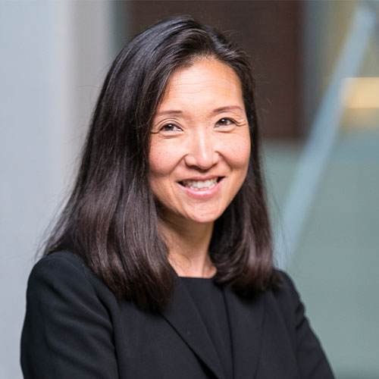
Closing
Anna E. Schoenbaum, DNP, MS, RN-BC, FHIMSS
Vice President, Information Services of Applications
Penn Medicine

Slide 34
Next Steps for Health IT Vendors and Organizations
Work towards standardization and collaboration
      What variables define the social determinants of health and the appropriate screening tools to track these variables
      Consistent data and measurements
      Accurately match patients to health information
      Work collaboratively in the community
Improve integration
      Data exchange between healthcare and public health organizations and social service organizations
      Integrated healthcare-based solutions for the core problems such as access to care, poverty and food insecurity
Take action
      Get educated
      Ask your elected official for their support- there are many policies being voted to address SDOH
      Participate in local, state, and global efforts
    Data privacy and security
35

Slide 35
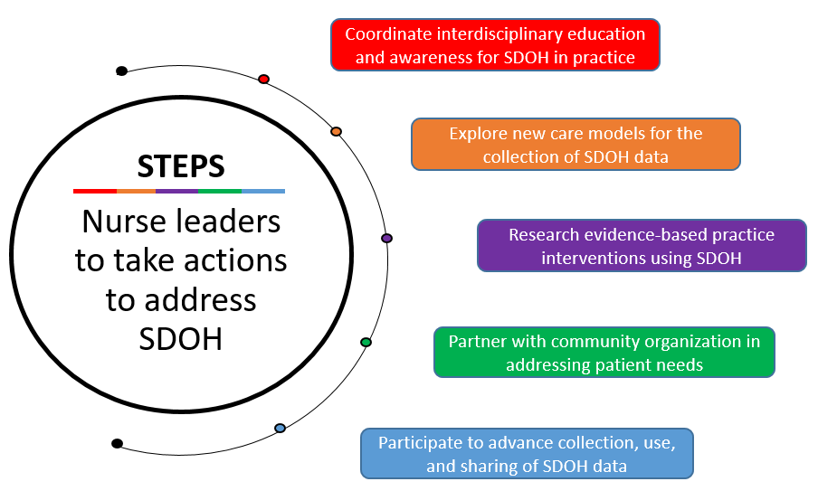
Next Steps for Nurse Leaders
Crookston, C., Schoenbaum, A.,Tiase, V., Valu, M., (in press). Nursing 2022. The Vital Role of Nursing in Addressing Social Determinants of Health.

Slide 36
Questions?

Slide 37

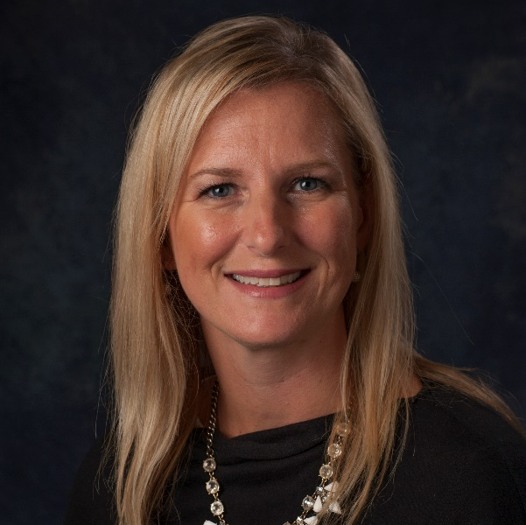
Questions? Contact us!
Cait Michicich, MBA
Tammy Kwiatkoski, MBA
Program Manager, Clinical Informatics, HIMSS
Director, Clinical Informatics, HIMSS
cait.michicich@himss.org
tammy.kwiatkoski@himss.org

Slide 38
Thank you for joining!

